Slide 1
Library Management System
Supervised By:
Dr. Priyanka Dahiya
Assistant Professor(MCA)
Submitted By :
Ajay
Rohit Singh Gusain
Deepak Rawat
Charu Joshi

Slide 2
Objective
To handle the entire activity of a library.
To provide easy system circulation using computers rather than writing system.
To modernize library database, where data was stored in a card-based catalog.
To optimize the system users’ work and time.

Slide 3
Introduction
System has 2 users: Admin & Receptionist.
System allows Admin to:
add/remove books to/form the library database.
order books alongside the requests of the members
maintain the system run operationally.
System allows Receptionist to:
search library’s books
move books physically and update the location in system.
receive the notifications of the system.
check the availability of the requests manually

Slide 4
Functional Requirements
Store necessary information about items in the library database.
Store information about the library members.
Allows search of item by author, title or keywords.
Notify the members automatically by e-mail.
−
Generate reports like overdue notification, requested items availability and so on.
−
Store information about each shelf in the library.

Slide 5
Summary
Library management system is a project which aims in developing a computerized system to maintain all the daily work of a library.
The system helps both students and library manager to keep a constant track of all the books available in the library.
It allows both the admin and the student to search for the desired book.

Slide 6
Summary
The main feature of this system is that all the books available in the library can be displayed in a list so that students need not roam through the entire library to find a book.
Additionally, the application effectively maintains the details of users/students to whom books have been issued; it also records the issued date and return date.

Slide 7
User Requirements
− Users should have the basic knowledge about the internet and web related applications, and the basic computer using.
Legal Requirements
- All personal information should be protected.

Slide 8
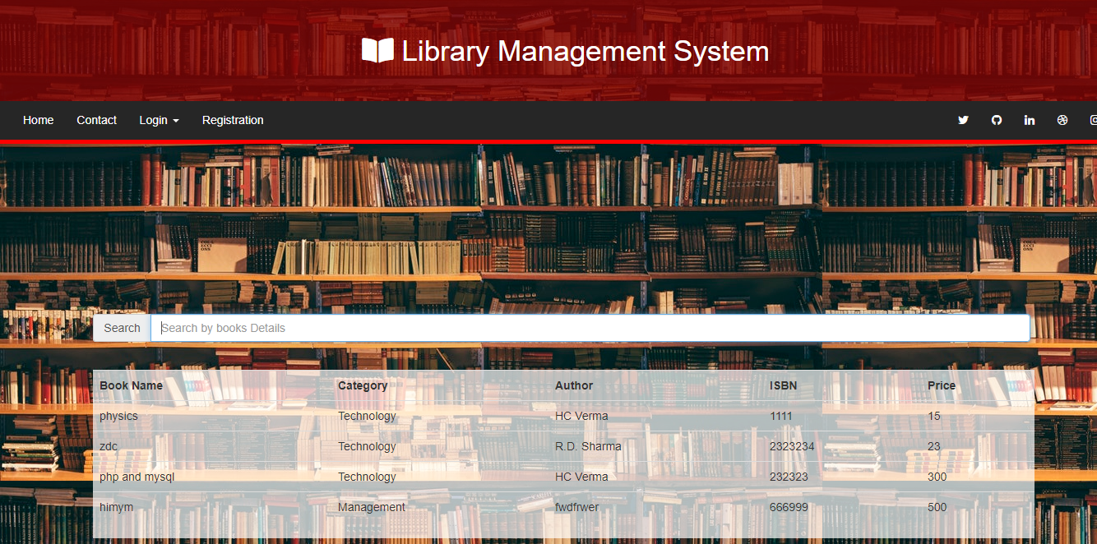
Home Page

Slide 9
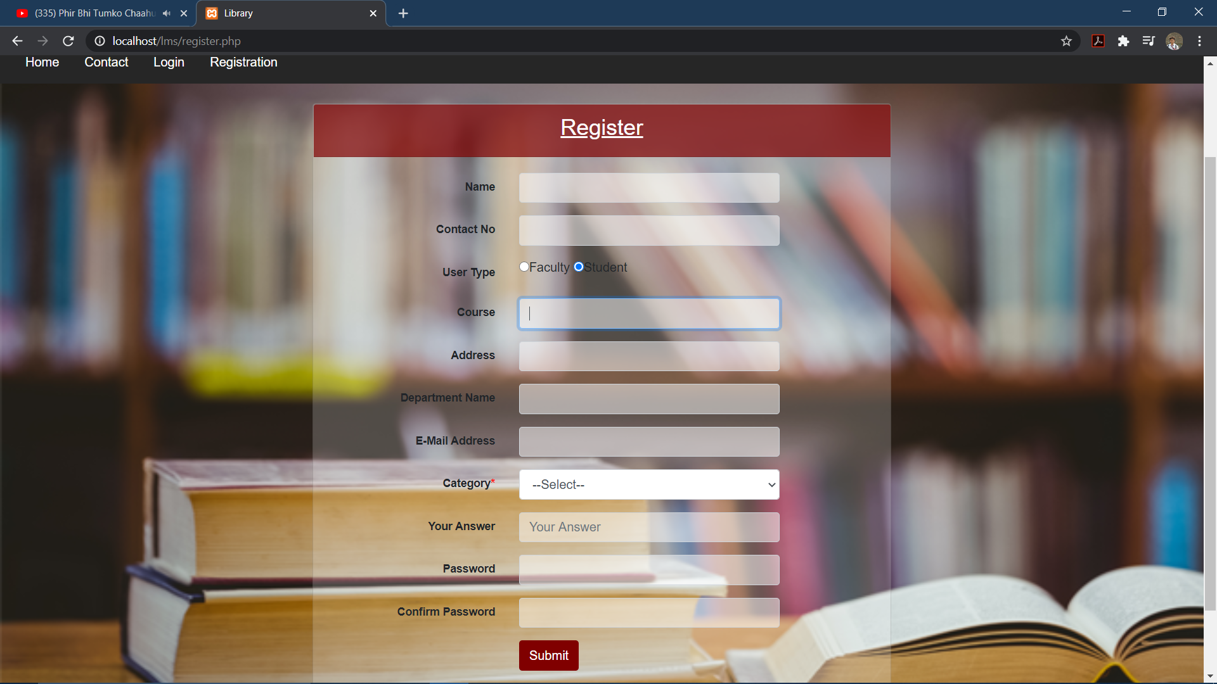
Registration Page

Slide 10
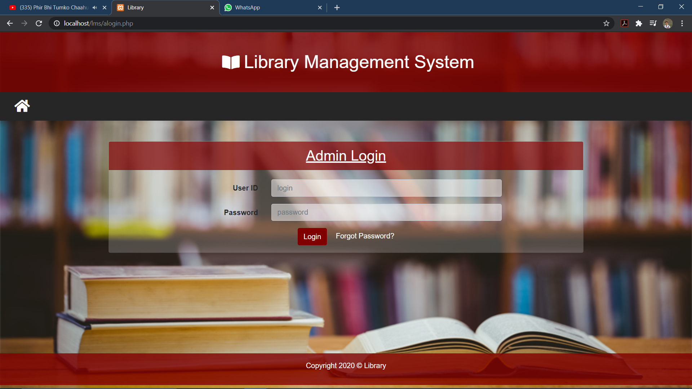
Admin Login

Slide 11

User Login

Slide 12
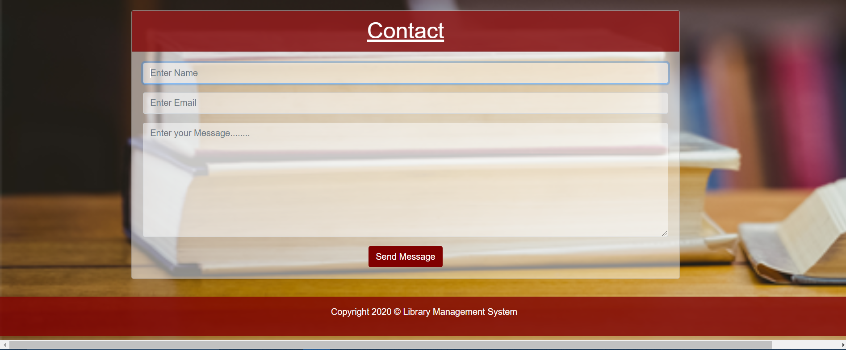
Contact to admin

Slide 13
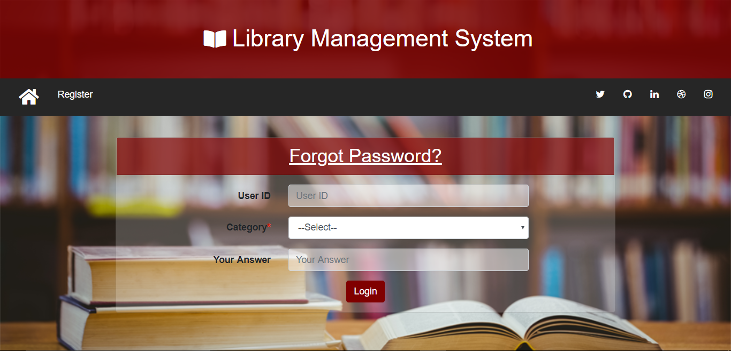
User forgot password

Slide 14
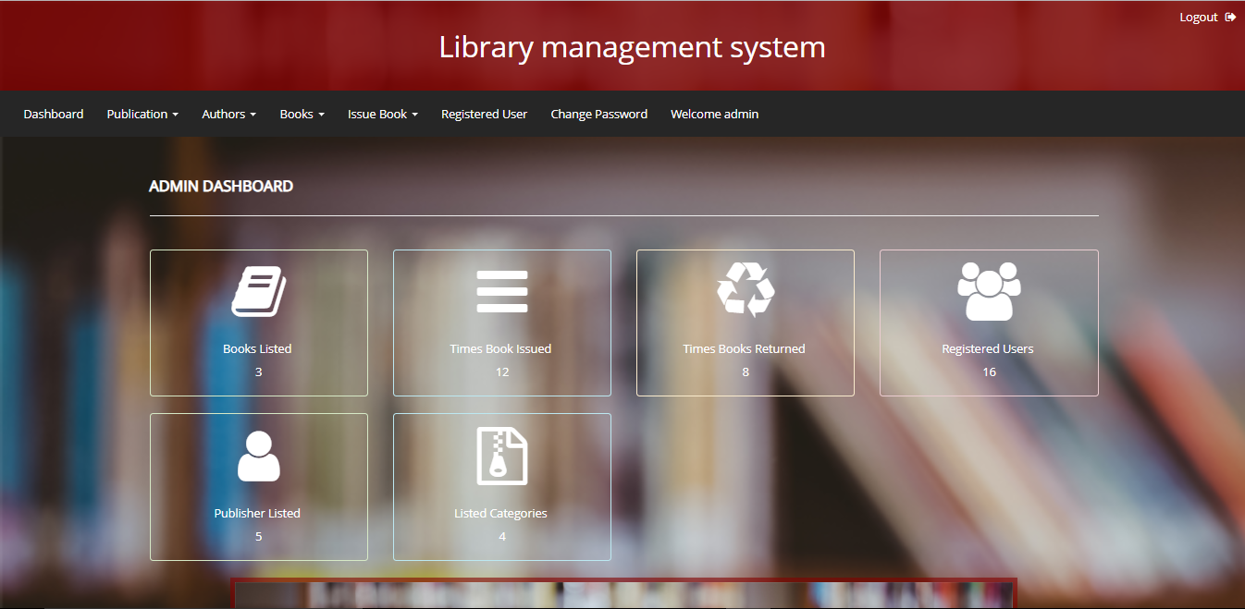
Admin Home Page

Slide 15
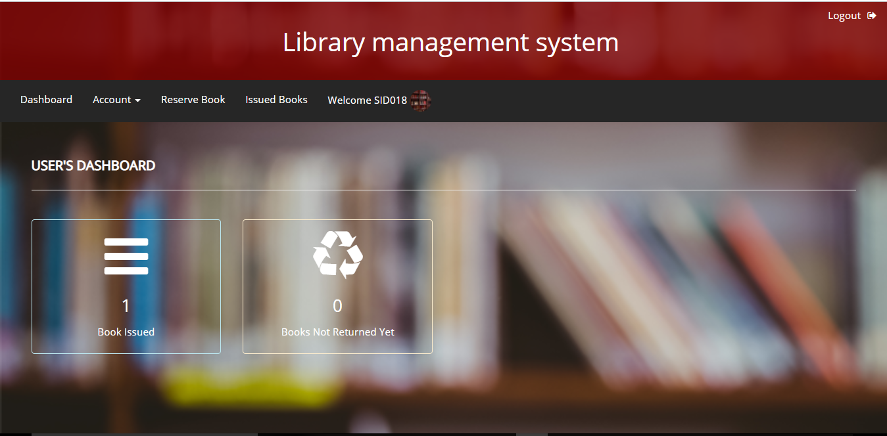
User Home Page

Slide 16
Technologies/Concepts Learned
We have learnt about the php and its connectivity with DB,
Mysql.
Concepts of CSS,HTML are used.
Use various IDEs
Make use of various tools and libraries.

Slide 17
Bibliography
Webistes:
www.Stackoverflow.com
www.w3school.com
www.javatpoint.com
www.tutorialpont.com

Slide 18
Thank You

